Slide 1
Yanfeng Visteon SUPPLIER APQP PORTAL
Project Discussion / 项目讨论
Jan 3rd 2018
V3.0

Slide 2
Agenda/议程
Omnex & Yanfeng Team Introductions / 团队介绍
Customer Requirements / 客户需求
Background & Pain Point / 需求背景和痛点
Requirements Specification / 需求说明
Understanding of Customer Requirements / 需求理解
Functional Requirements / 功能性需求
OMNEX Solution / OMNEX 解决方案
Application Architecture / 应用架构
System Infrastructure / 系统部署架构
Application Feature List / 应用功能清单
Project Implementation Methodology / 项目实施方法论
Implementation & Release Plan / 实施和发布计划
Q&A / 问题与回答

Slide 3




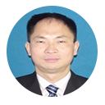







Omnex Project Org Chart / 奥曼克项目组织架构图
Chad Kymal, Arun Kumar, Dave Watkins
TOP MANAGEMENT / 最高管理层
Michael Xu | Antony John
Michael Zhu
Sharon
Evin Xiong
Global Software Development
Christin
Steven Wang
R S Sabu
Clarence Jiang
Dora Yin
Wendy Wan
Development Team will be based out of Shanghai, India & USA.
开发团队将在上海，印度和美国

Slide 4
Yanfeng Visteon Project Team
Site / 站点 | Name / 名称 | Project role / 项目角色
Songjiang | Li Zhuo | Project Lead
 | Wang Jianjun | Key User
 | Zhang Yuanhua | Key User
 | Wang Zheyu | Key User
 | Zheng Jian | Key User
 | Hong Xiaodong | Key User
YFVIC | Wu Leilei | Project CO-Lead

Slide 5
Agenda/议程
Omnex & Yanfeng Team Introductions / 团队介绍
Customer Requirements / 客户需求
Background & Pain Point / 需求背景和痛点
Requirements Specification / 需求说明
Understanding of Customer Requirements / 需求理解
Functional Requirements / 功能性需求
OMNEX Solution / OMNEX 解决方案
Application Architecture / 应用架构
System Infrastructure / 系统部署架构
Application Feature List / 应用功能清单
Project Implementation Methodology / 项目实施方法论
Implementation & Release Plan / 实施和发布计划
Q&A / 问题与回答

Slide 6
Customer Requirements / 客户需求 - Background & Pain point / 背景和痛点
YFVE is using traditional work methods for Supplier Quality Management
E-mails to track the status of APQP,PPAP,PPQP of each suppliers;
No single point data collection and storage,
need lots of time to consolidate data,
low work efficiency.
YFVE is supposed to improve their Supplier Management Efficiency and manage the risks, and then build up a efficient information management system to monitor the APQP/PPAP/PPQP process, track issues, manage Supplier Metrics.
Cooperative work required from multi-entities, then the Content management (mainly for Document management and Version control) requirement is mandatory.

Slide 7
Customer Requirements / 客户需求 - Requirements Specification / 需求说明
To build up an APQP management platform for suppliers and realize the submission, approval, monitoring, statistics and storage of the system. The main functions are listed below:
Task start up: integrate with YFVIC system to trigger the task automatically, or trigger the task manually.
Data submission: suppliers have to submit all the tasks by the pre-defined time line, and suppliers will get notifications automatically before each time line.
Approval: YFVIC SQE will audit the materials that submitted by the suppliers and decide to reject or approve the application online. The system should allow YFVIC SQE to log the reject reasons or comments, and all the historical records should be logged automatically.
Monitoring: Any tasks expired (violating need date), the system should send notification to SQE and suppliers, and also escalate the tasks to higher level managers according to the expired date pre-defined.
Statistics (report): Generate report by three dimensions (by projects, by suppliers, by SQE)
ALL BUSINESS DATA NEED TO BE STORED AT LEAST FOR 15 YEARS.
EXTERNAL INTERFACE: Realize the standard input/output functions according to YFVE’s detailed requirements.

Slide 8
Agenda/议程
Omnex & Yanfeng Team Introductions / 团队介绍
Customer Requirements / 客户需求
Background & Pain Point / 需求背景和痛点
Requirements Specification / 需求说明
Understanding of Customer Requirements / 需求理解
Functional Requirements / 功能性需求
OMNEX Solution / OMNEX 解决方案
Application Architecture / 应用架构
System Infrastructure / 系统部署架构
Application Feature List / 应用功能清单
Project Implementation Methodology / 项目实施方法论
Implementation & Release Plan / 实施和发布计划
Q&A / 问题与回答

Slide 9

Requirements Understanding - Functional Requirements – Main Process
根据外部输入
任务选择
开启/关闭或重新开启模块及具体任务
根据外部输入
任务选择
开启/关闭或重新开启模块及具体任务
upload
HIS证明
建立料号，录入基本信息，项目责任人定义
SNL
APQP
PPAP
PPQP
PPAP
PPQP
定期跟踪APQP状态
ASDE/SQE 上传PSW
ECR
分配任务
责任人接收料件任务
各项任务完成完任务关闭
yes
批量导入
5. HIS与否
(系统评估结果和附件)
项目交接
Single part
End

Slide 10
Requirements Understanding - Non-Functional Requirements
Provide a 1 liner for each
The application should be deployed on the cloud, and the following characteristics should be considered :
Usability : System should be User-friendly with minimum clicks to complete each function
Availability : 99.9% uptime on internet zone. Planned Backup and maintenance will be done during week ends / off peak hours.
Scalability: Select the amount of RAM required for running the application and then scale up and out dynamically
Security : End to End Encryption using TLS 1.2 and Data At Rest Encryption
System Logging strategy: User access logs to application, Transaction logs for key transactions

Slide 11
Agenda/议程
Omnex & Yanfeng Team Introductions / 团队介绍
Customer Requirements / 客户需求
Background & Pain Point / 需求背景和痛点
Requirements Specification / 需求说明
Understanding of Customer Requirements / 需求理解
Functional Requirements / 功能性需求
OMNEX Solution / OMNEX 解决方案
Application Architecture / 应用架构
System Infrastructure / 系统部署架构
Application Feature List / 应用功能清单
Software Prototype / 软件原型
Project Implementation Methodology / 项目实施方法论
Implementation & Release Plan / 实施和发布计划
Q&A / 问题与回答

Slide 12


YANFENG SUPPLIER APQP PORTAL / 延锋供应商APQP入口
SUPPLIER
METRICS /
供应商指标
PROJECT /
PROGRAM
MGMT
项目/程序（大项目）管理
SUPPLIER
PORTAL
供应商入口
Supplier
APQP
PORTAL
供应商
APQP入口
DOCUMENT
MGMT/
文档管理
ISSUES / RISK
MGMT
/问题/风险管理

Slide 13


Yanfeng Visteon - Supplier APQP Portal
OMNEX Solution Proposed - Application Architecture
YANFENG Internal User
Supplier Portal
Yanfeng APQP Modules
Supplier Modules
S
O
A
User Home Page, Supplier Management, APQP Program Management, Report Manager, Task Management, Issue Management, Document Management, Project Template Management, System Setup
Supplier Home Page, Supplier APQP/PPAP Program, Supplier Task, Supplier Issues, Supplier Actions, Supplier Document, Supplier News, Supplier Calendar
BPM
Business Processes
Project Plan Release
Issue Management
TR
Document Review
Supplier Document Release
SCR
Components
Business Component
Workflow/Rules Engine
Document Repository
Program Template
Gate Review Checklist
Activity Directory Integration
SOA
(System Connectivity)
PPQP
Checklist
Project Deliverable Review Checklist
Database

Slide 14
OMNEX Solution Proposed - System Architecture
PPQP
APQP
PPAP
Supplier Quality Management System
Pur
System Setup
Supplier Management
Project Management
SQEM
Issue/Risk Management
Report Management
Task Management
SQE
Content Management
APQP/PPAP Program Management
Others(Mail, Notification…)
SUPPLIER
data
doc
data
BPM(modifications, project kick-off…)
DMS(Hyper-link to file server)
QAD(Suppliers’ information)

Slide 15
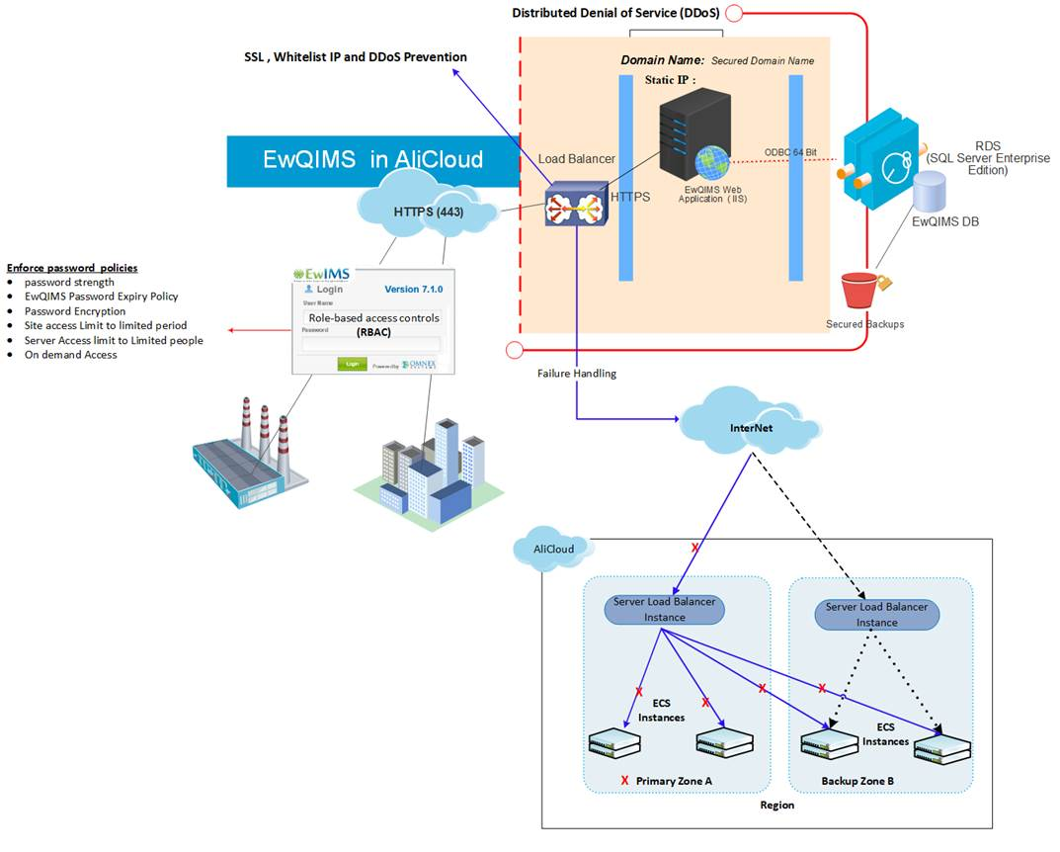
Solution Deployment on Ali Cloud
Notes:
1, need a diagram to demonstrate the whole system’s infrastructure;
2, need to avoid the single point of failure in our design;
3, the suggested hardware configuration should be provided here(according to user’s usage situation);
Total users number will be 500 or more;
According to Li Zhuo’s estimation, the concurrent users at peak time will be 100-200,

Slide 16
OMNEX Solution Proposed - System Feature List
@Sabu, we can use the one you presented in the meeting
 | 模块/功能 | Modules/Features | Readiness from Omnex Side | Omnex Comments
1 | 系统设置 | System Setup
1.1 | 组织与用户管理 | Organization Structure and User management | Available
1.2 | 提供企业内部角色与权限的创建和维护功能，实现基于角色的权限管理机制 | RBAC - role based access control | Available
1.3 | PPAP 等级设置 | PPAP Level Setup | Partially Available | Need to know the exact requirement to understand the Gap. As per the discussions on 1st February 2018, YFVE will provide the data required for setting up PPAP levels
1.4 | 供应商风险等级设置 | Supplier risk update | Partially Available | We think this is a decision taken outside of the system and based on risk status PPAP level is ascertained. If this is to be performed in the system let us know we can develop the rest. As per the discussion on 1st February 2018, YFVE told that this will be a step taken outside of the supplier management system and will be manually updated in the system.
2 | 供应商信息管理 | Supplier Setup | Available
2.1 | 供应商基本信息管理 | Supplier Profile | Available
2.2 | 供应商用户管理 | Supplier Portal User Management | Available
2.3 | 供应商角色管理 | Supplier Role Management | Available
2.4 | 供应商状态与风险等级管理 | Supplier Status & Risk Update | Partially available | We have provision to update the supplier risk status for the supplier. But supplier risk status for each part will vary and this is our assumption. Hence request more clarity on this. As per the discussion on 1st February 2018, YFVE told that this will be a step taken outside of the supplier management system and will be manually updated in the system.

Slide 17
OMNEX Solution Proposed - System Feature List Cont.…
 | 模块/功能 | Modules/Features | Readiness from Omnex Side | Omnex Comments
3 | 项目管理 | Project Management
3.1 | 项目模板管理 | Project Template Management | Available
3.2 | 项目架构管理 | Project Entity Structure | Available
3.2 | 项目组织管理 | Project Organization Structure | Available
3.3 | 项目文档管理 | Project Document Management | Available
3.4 | 项目查询 | APQP Program List | Available
 | 新建项目 | New APQP Program | Available
 | 计划编辑 | Edit Project Schedule | Available
 | 计划发布 | Program Charter Release | Partially Available | We can create program charter and can import part details which will create the program and supplier projects. Need more clarity on the scope to determine what is meant by Charter release.
 | 添加物料（任务） | Add New APQP Project | Available
 | 计划导入 | Batch APQP Project Import | Partially Available | We can import BOM structure in program charter and can create program and projects. Need to know the requirement clearly to understand the Actual scope.
 | 项目分解 | Project Breakdown | Available
 | 项目合并 | Project Merge | Not Available | As per the discussion on 1st February 2018, there is no such requirement to be done in the system. This will be manually handled by SQE and needs a reference to the older project
 | 基线管理 | Baseline | Available

Slide 18
OMNEX Solution Proposed - System Feature List Cont.…
 | 模块/功能 | Modules/Features | Readiness from Omnex Side | Omnex Comments
3.5 | 项目任务管理 | Task Management | Available
 | 任务进度更新 | Task Status Update | Available
 | 任务延期 | Task Extention | Partially Available | We have the facility for supplier project manager / SQE to extend the project task timeline. But it will not go for approval. Need to customize this feature to include approvals.
3.6 | 项目会议管理 | Meeting Management | Available
3.7 | 样品管理 | Sample Plan Management | Not Available | As per the discussion on 1st February 2018, there is no such requirement to be done in the system.
 |  | Sample plan tracking | Not Available | As per the discussion on 1st February 2018, there is no such requirement to be done in the system.
 |  | Sample statistics | Not Available | As per the discussion on 1st February 2018, there is no such requirement to be done in the system.
3.8 | 项目变更管理 | Project Change Management
3.8.1 | 工程变更 | Engineering Change | Available
3.8.2 | 重点计划变更 | Project Schedule Change | Partially Available | We have the facility for supplier project manager / SQE to extend the project timeline. But it will not go for approval. Need to customize this feature to include approvals.
3.9 | 供应商图纸管理 | Supplier Document Management Supplier Drawing Management | Partially Available | Supplier documents can be managed by our system. As per our understanding the drawings will also be managed the same way or through a link to external system. Need to understand this better as we do not know if we need to integrate this with external systems.
 | 手工图纸下发 | Manual drawing release | Available
 | 供应商图纸批量下发 | Batch drawing release | Not Available | As per the discussion on 1st February 2018, there is no such requirement to be done in the system. However there need to be a queing system from DMS. Will share more details later.

Slide 19
OMNEX Solution Proposed - System Feature List Cont.…
 | 模块/功能 | Modules/Features | Readiness from Omnex Side | Omnex Comments
4 | 项目问题/风险管理 | Project Risk/Issue/Opportunity Management
4.1 | 新建问题 | Raise Issue | Not Available | Omnex Comments same as in 6.1.2
4.2 | Open Issue 处理流程 | Open Issue Process Flow | Not Available | Omnex Comments same as in 6.1.2
4.2 | 问题查询与统计 | Issue Search & Statistics | Not Available | Omnex Comments same as in 6.1.2
5 | 项目报表 | Report Manager
5.1 | 项目组合报告 | Project Portfolio Report | Available
5.2 | 项目一页纸报告 | Onge page single project report | Available
5.3 | 供应商项目进展报告 | Supplier project status report | Available
5.4 | SQE 项目进展报告 | SEQ project status report | Available
 | 企业用户登录首页 | Corporate User Home Page | Available
6 | 供应商用户登录首页 | Supplier User Home Page | Available
6.1.1 | 任务查看/任务处理（看板） | Supplier Task | Available
6.1.2 | 项目问题查看/处理(看板） | Supplier Open Issues | Not Available | Open Issues are repeated in this document for different context. We will provide an issue management system integrated with the supplier management solution which will be available for both Suppliers and SQE.
6.1.3 | 样件开发任务查看/处理（看板） | Supplier Sample Part Task | Not Available
6.1.4 | 通知与提示（看板） | Supplier Announcement | Not Available | As discussed on 1st Feb 2018, This is just a notification board for the supplier.
6.2 | 工程变更申请 | Enginering Change Request | Available
6.3 | 项目信息查看 | Project Information Board | Available | Need to configure as per YFVE requirements
6.3.1 | 项目基本信息 | Project Basic Information | Available
6.3.2 | 项目文档、交付物 | Project Document, Deliverable | Available
6.3.3 | 项目样件 | Sample Part Task | Not Available
6.4 | 项目问题管理 | Project Open Issue | Not Available | Omnex Comments same as in 6.1.2
6.4.1 | 新建问题 | Raise Issue | Not Available | Omnex Comments same as in 6.1.2
6.4.2 | 处理问题 | Resolve Issue | Not Available | Available in some form and shape. But need to know the actual requirement to understand the scope
6.4.3 | 问题统计 | Status Report & Statistics | Partially Available

Slide 20

Software Prototypes / 软件原型

Slide 21
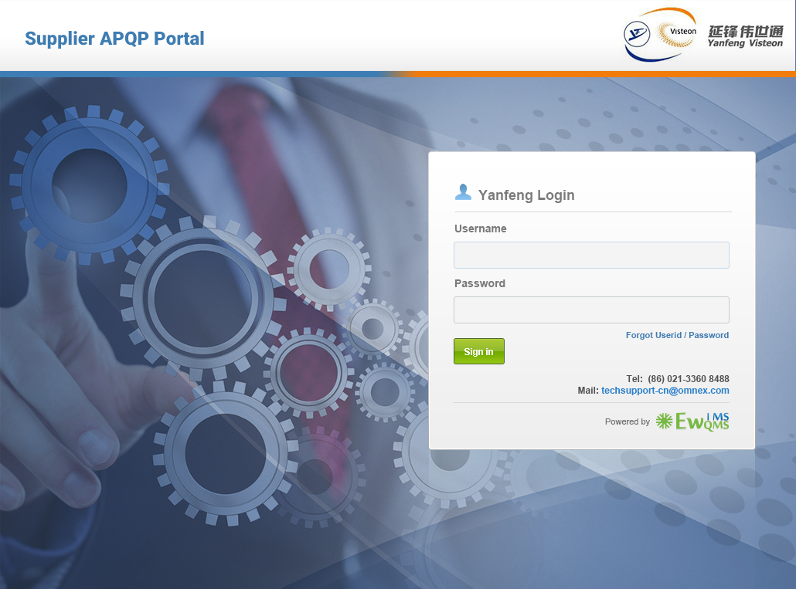
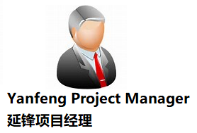

Slide 22
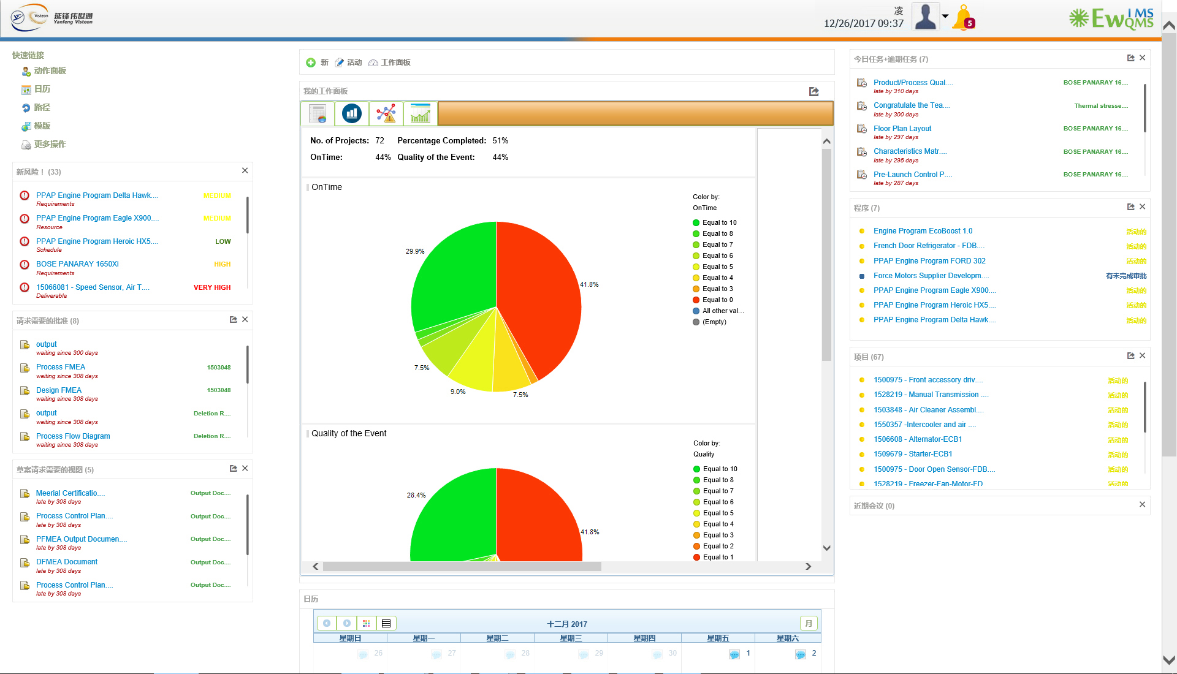

Slide 23
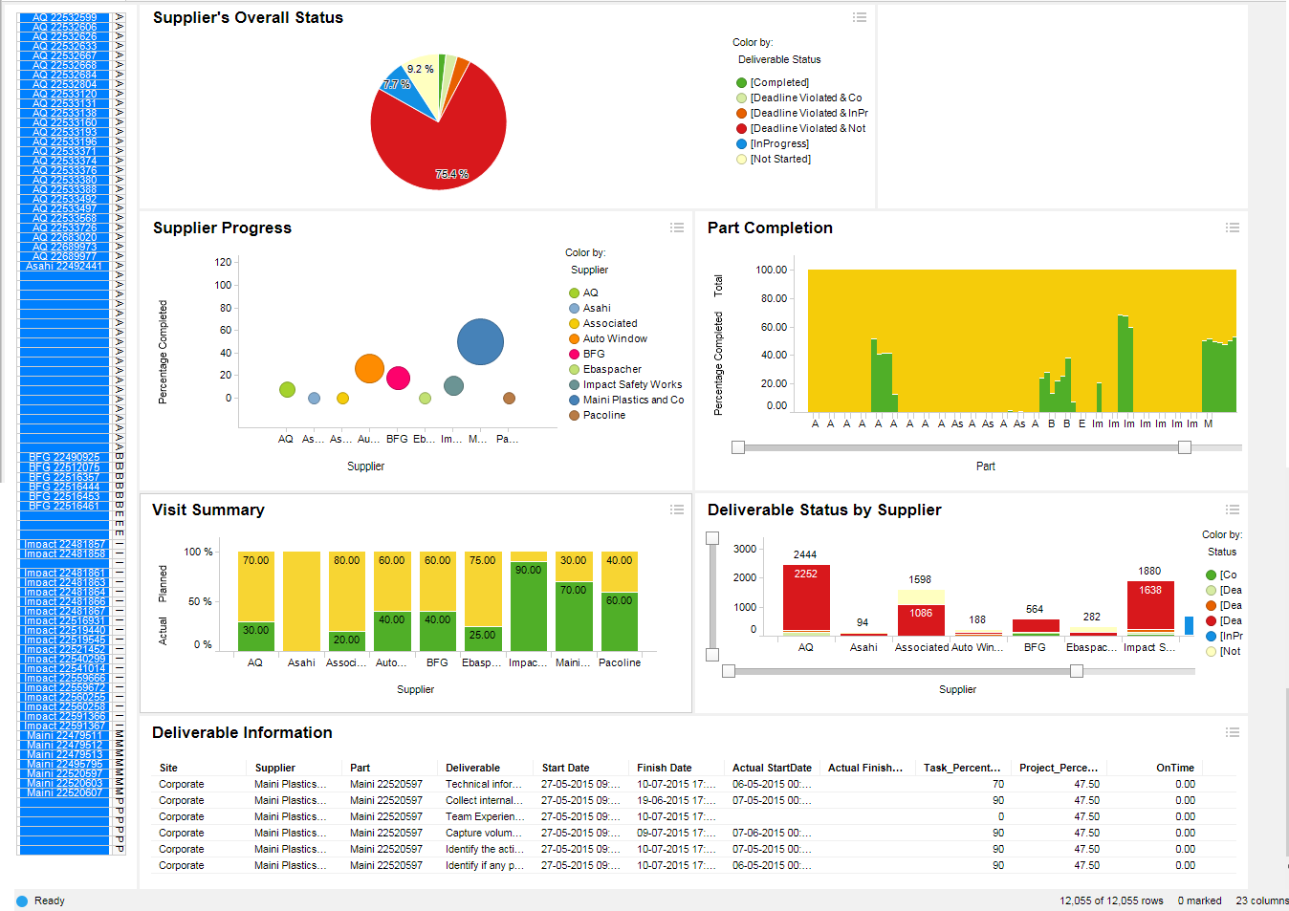

Supplier Dashboard / 供应商管理汇总表
v

Slide 24
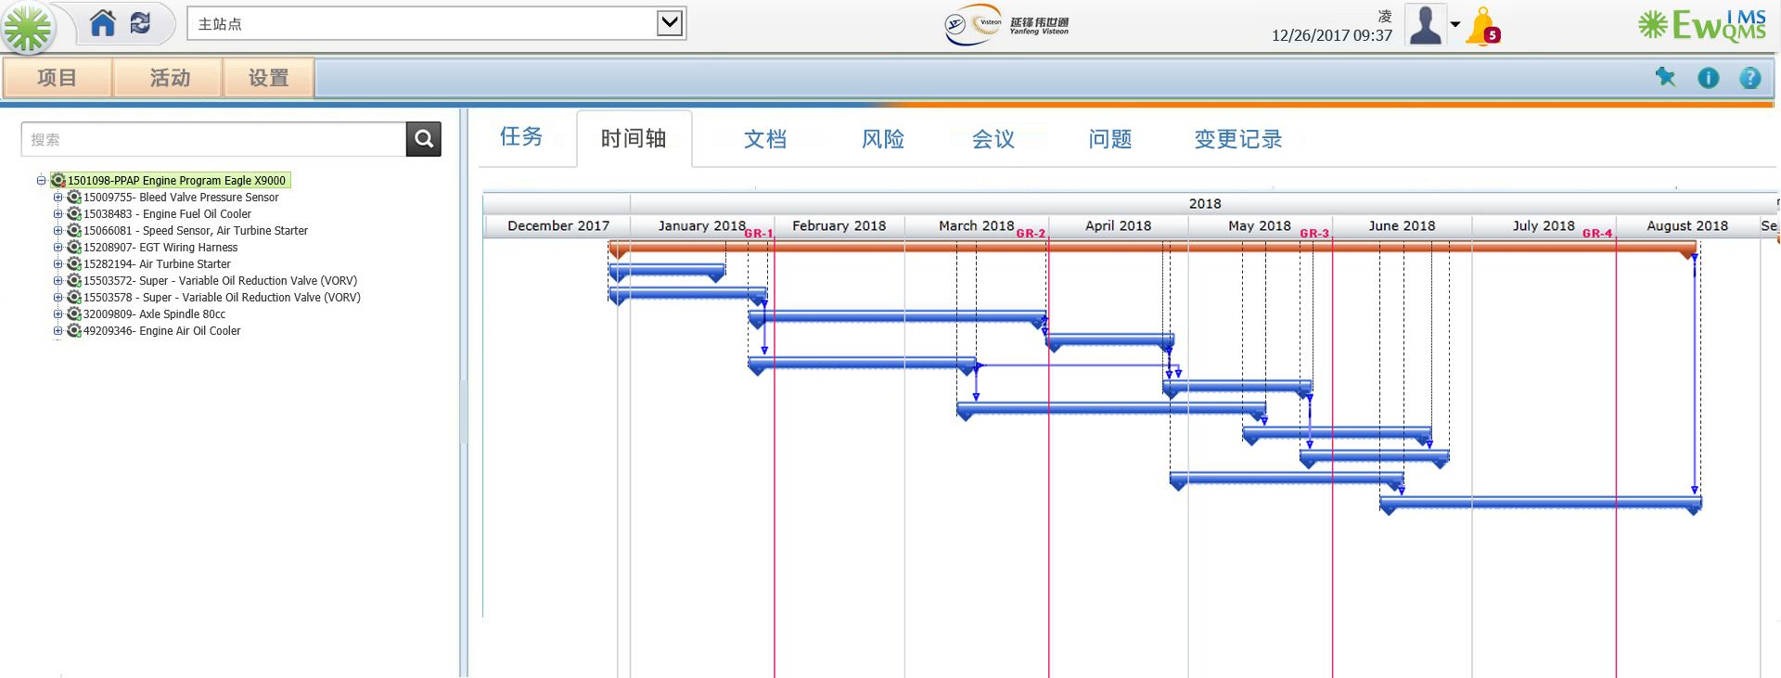

Slide 25
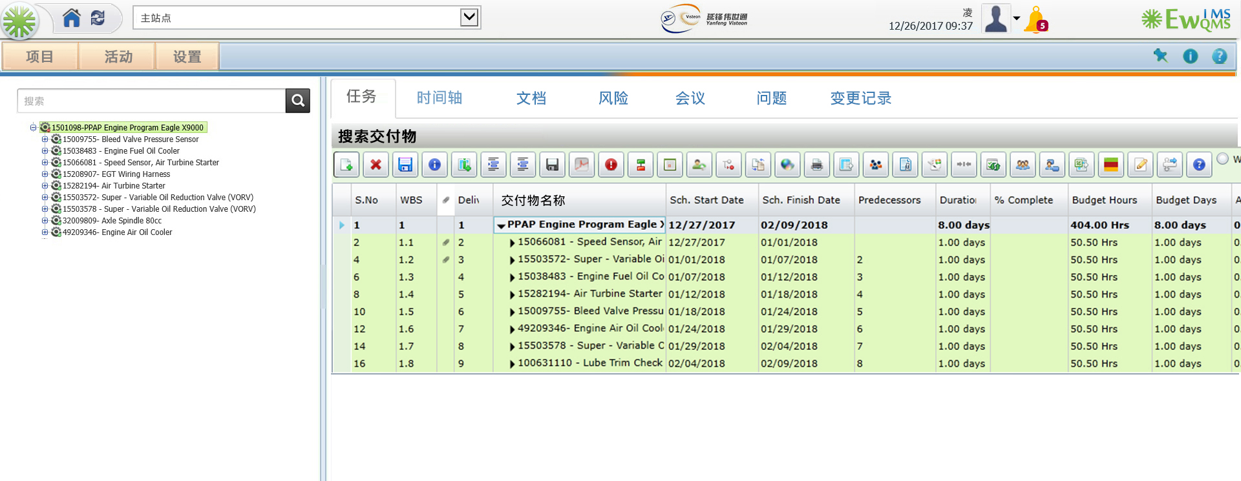

Slide 26
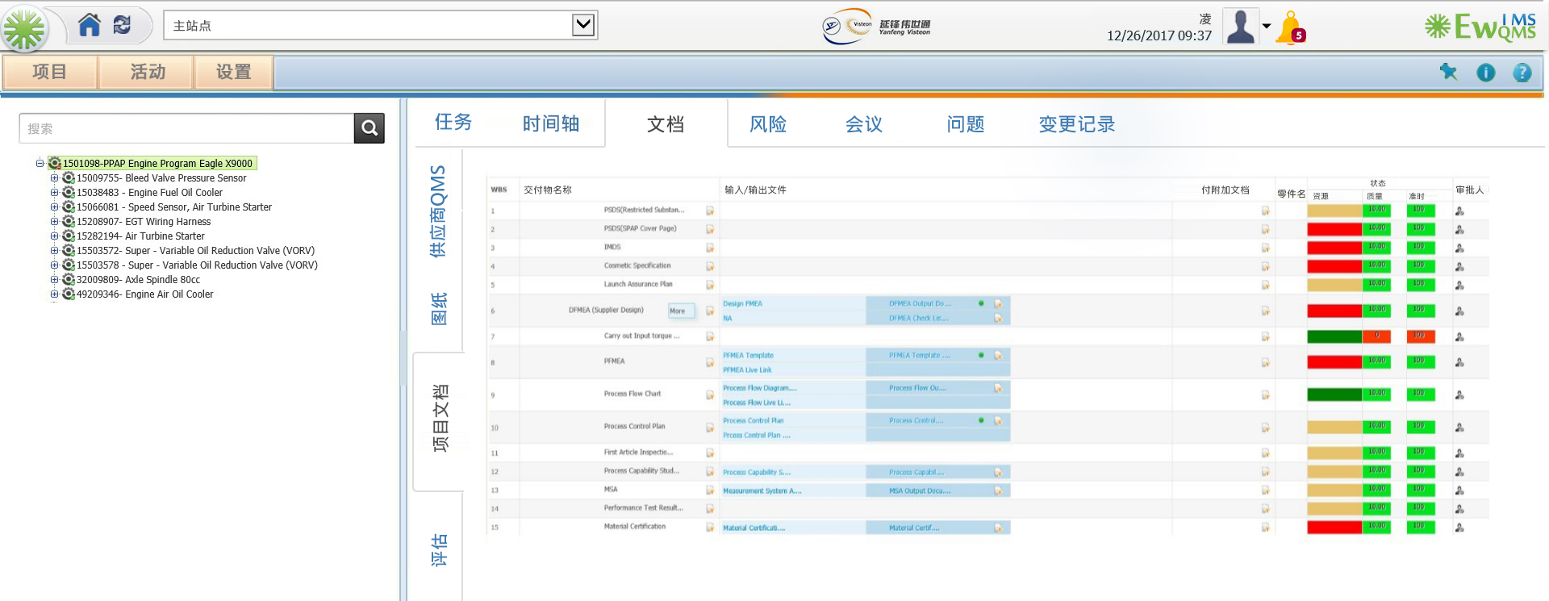

Slide 27
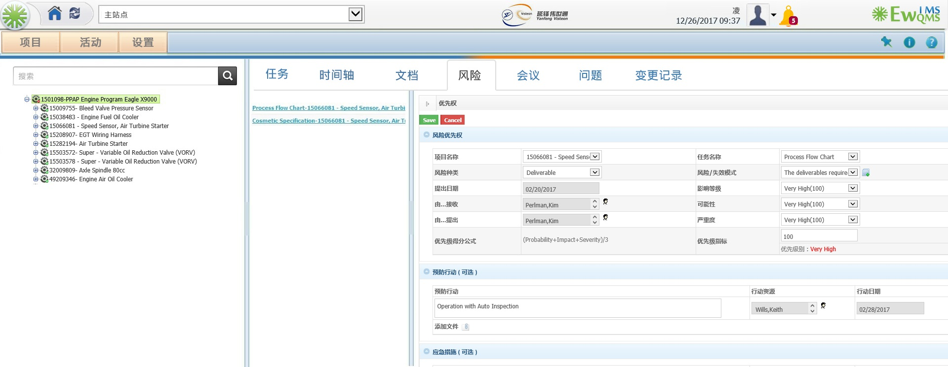

Slide 28
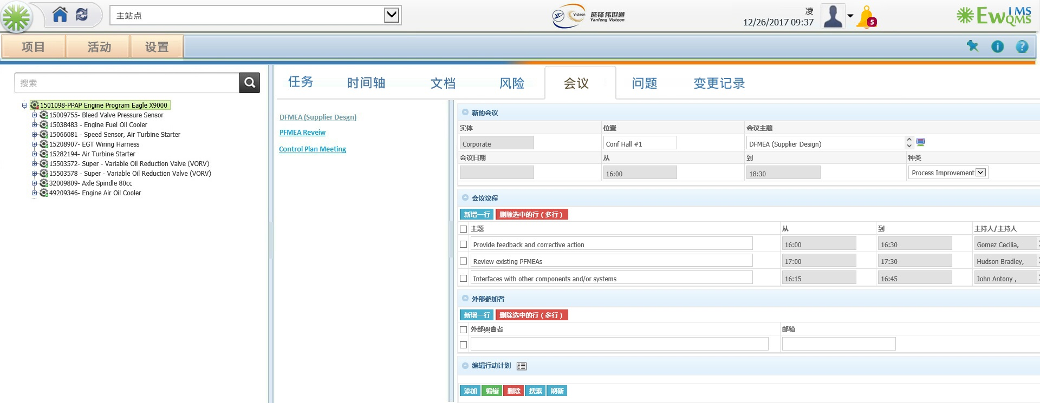

Slide 29
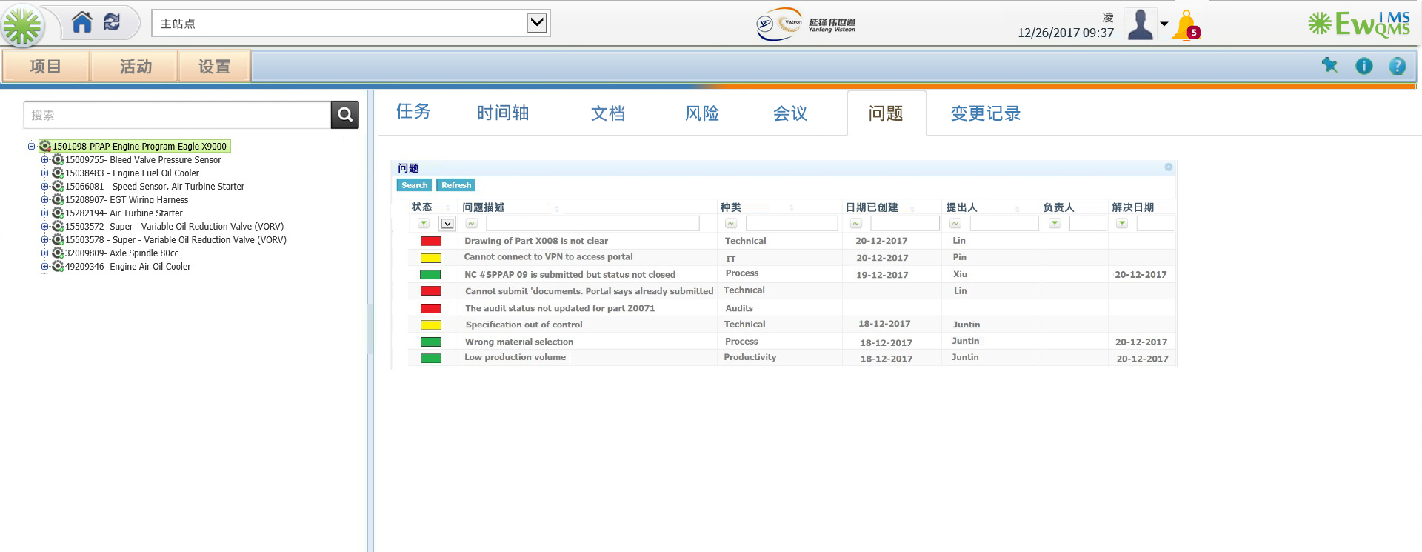

Slide 30
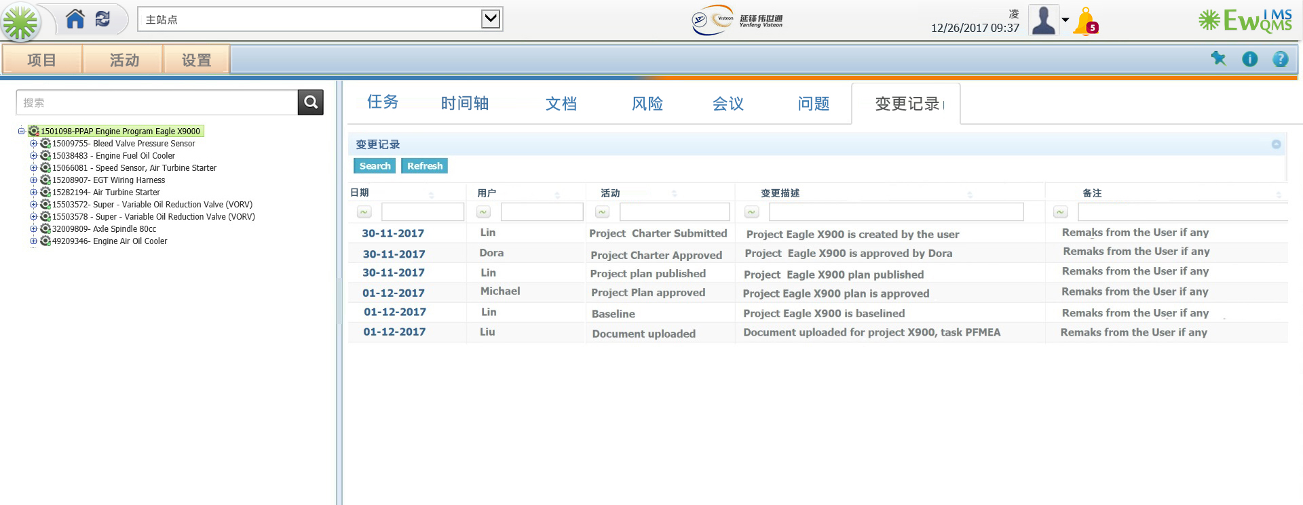

Slide 31
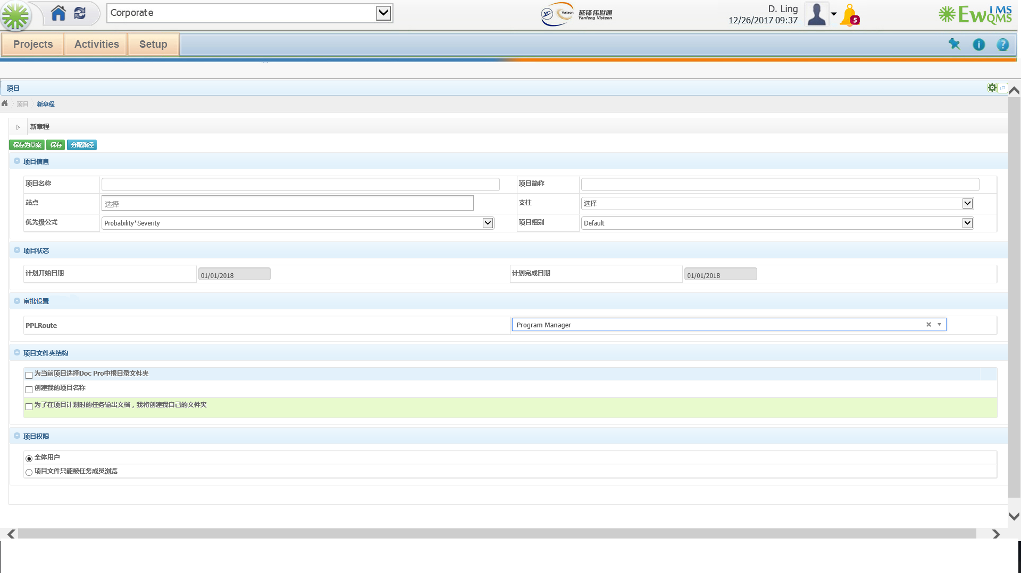
Project Charter/ 项目初始化

Slide 32
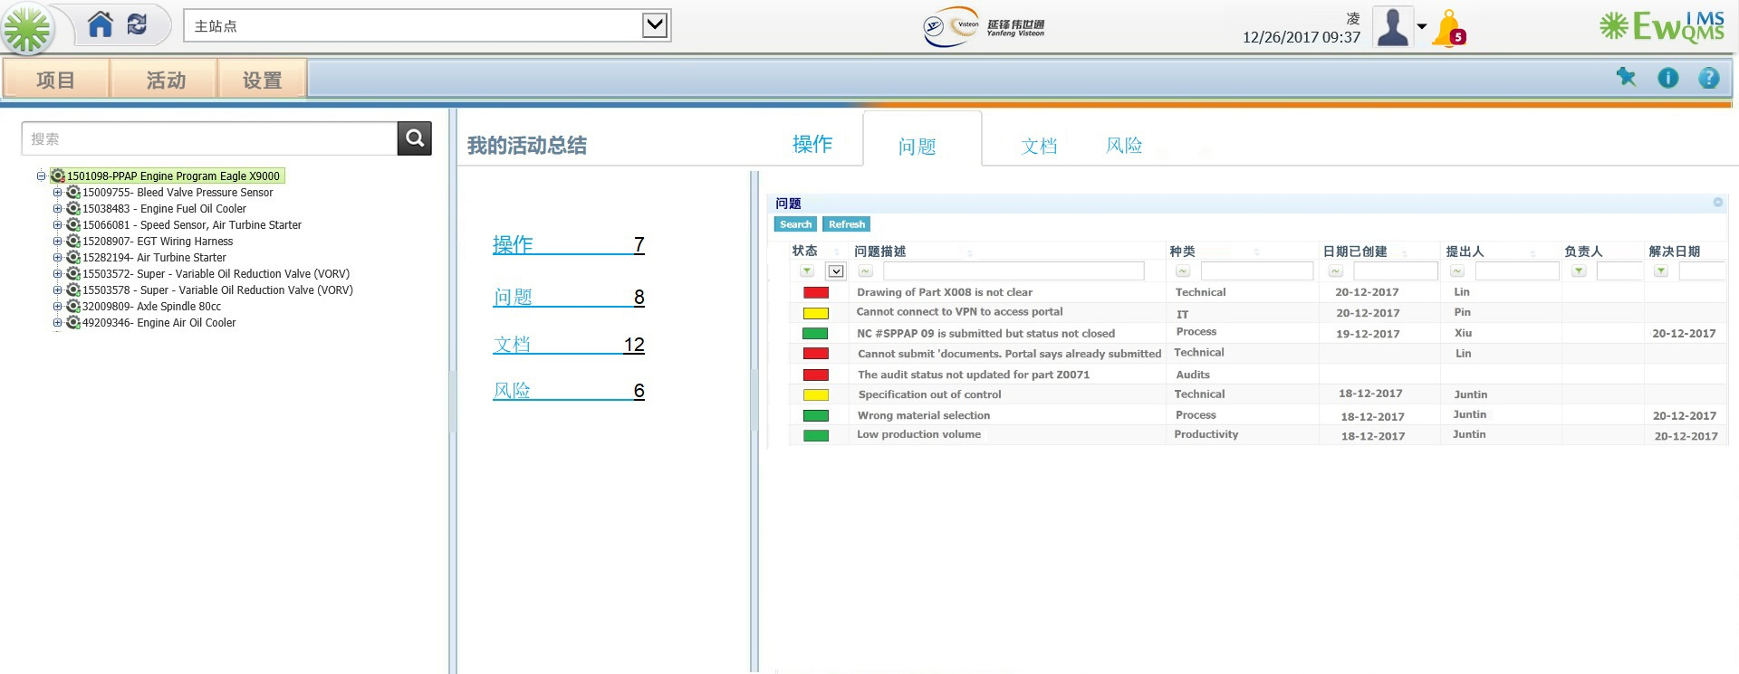
My Activities/我的任务列表

Slide 33
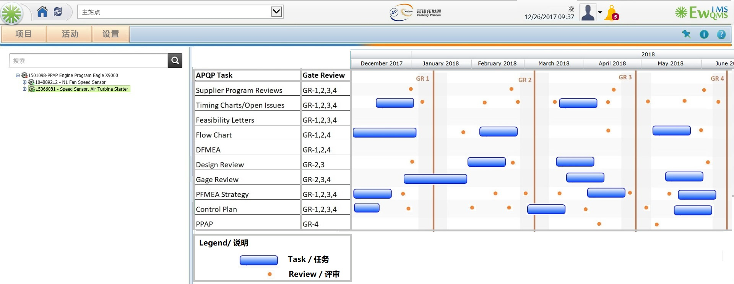

Slide 34
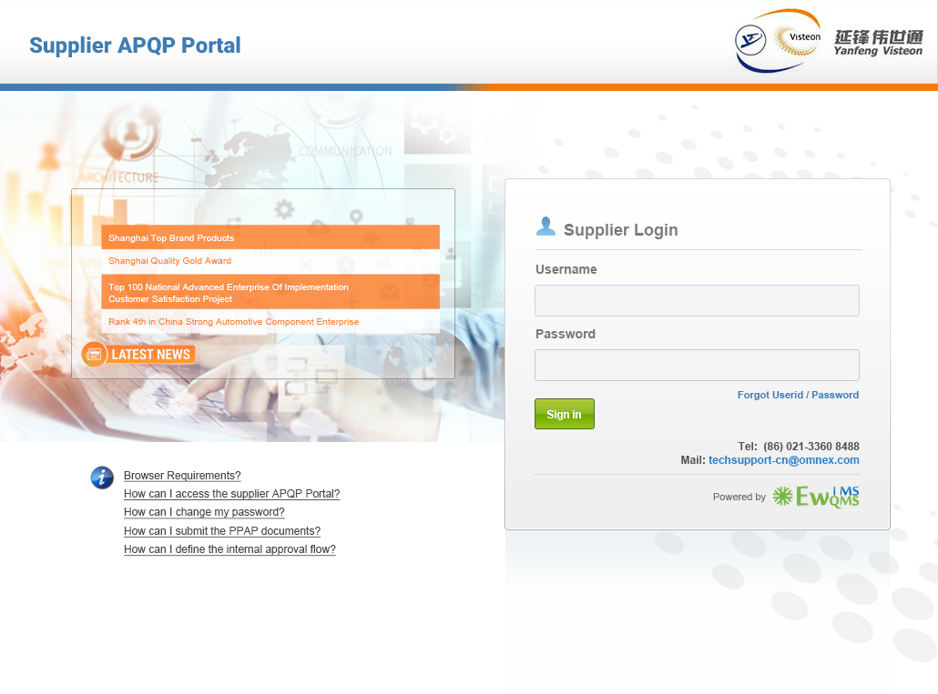


Slide 35
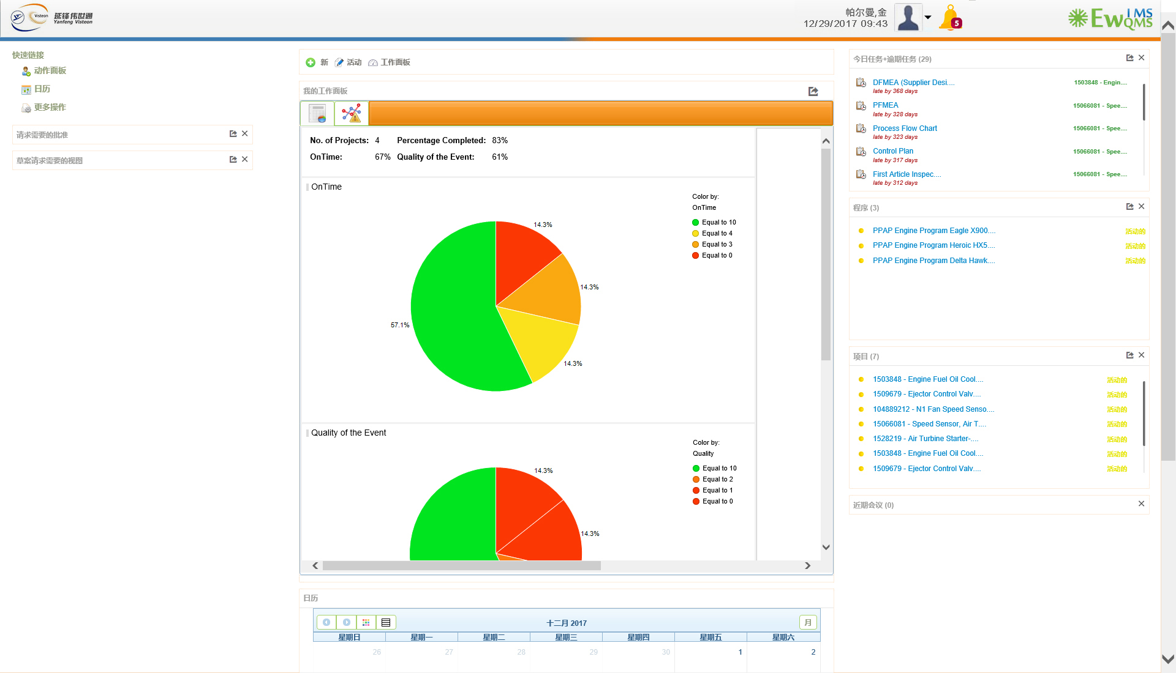

Slide 36
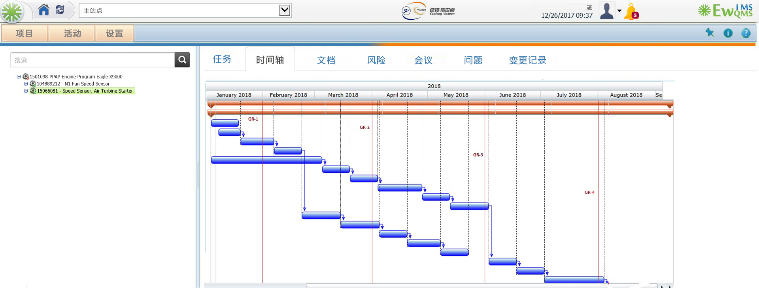

Slide 37
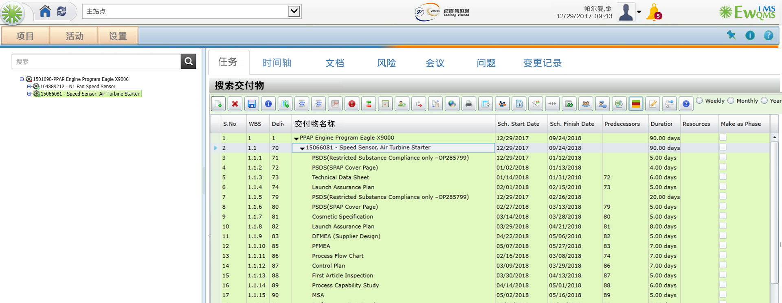

Slide 38
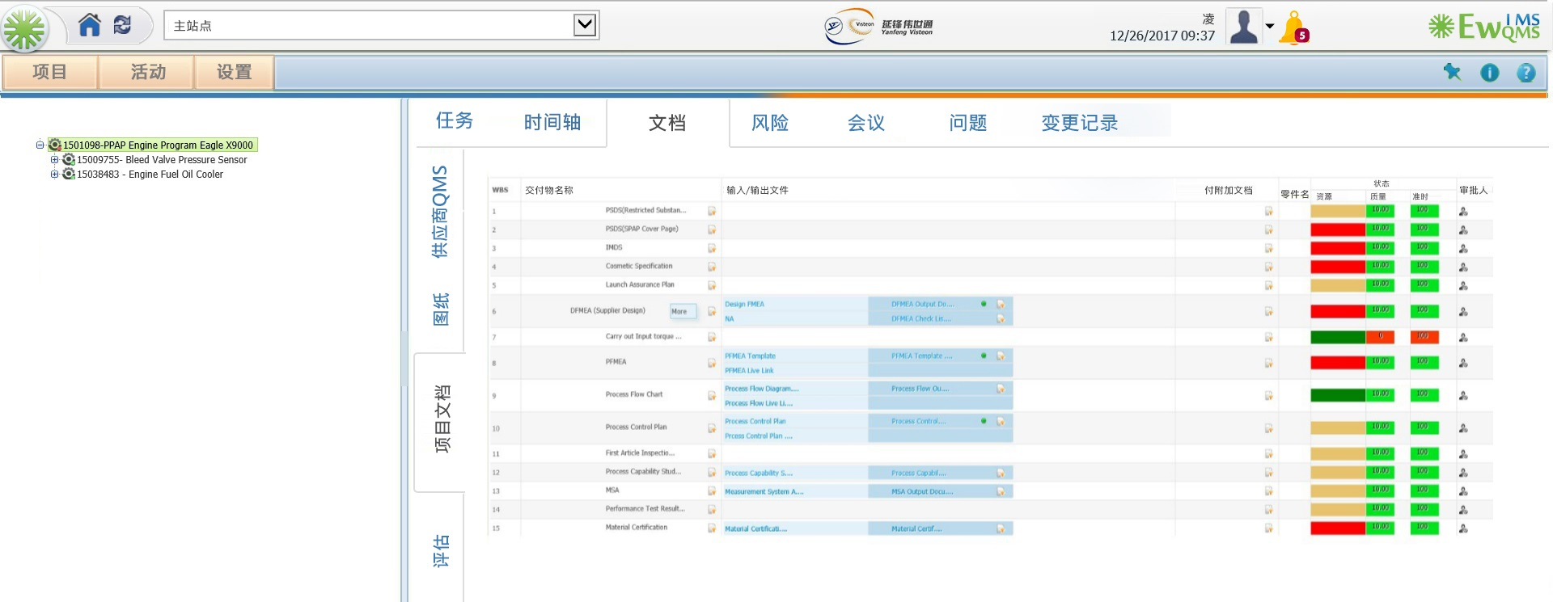

Slide 39
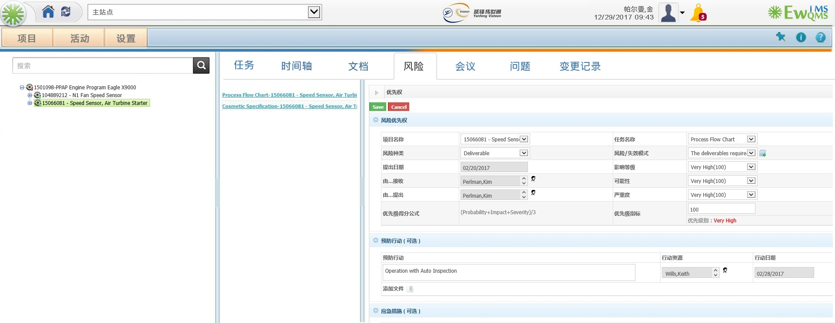

Slide 40
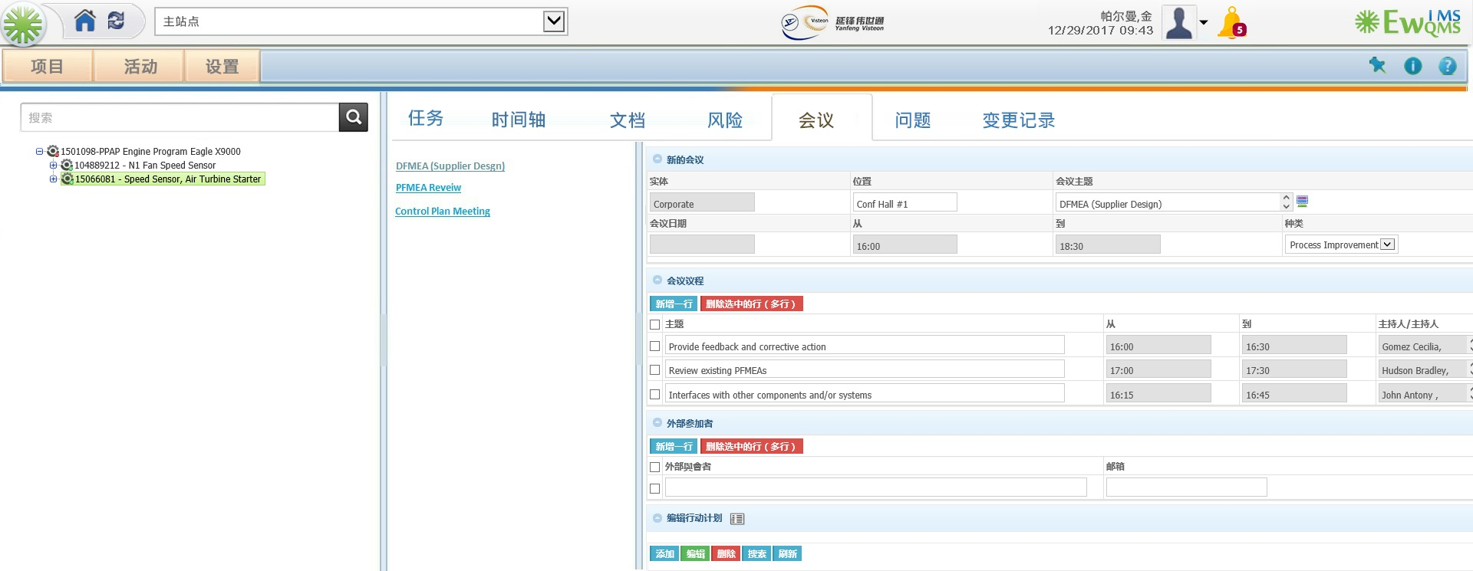

Slide 41
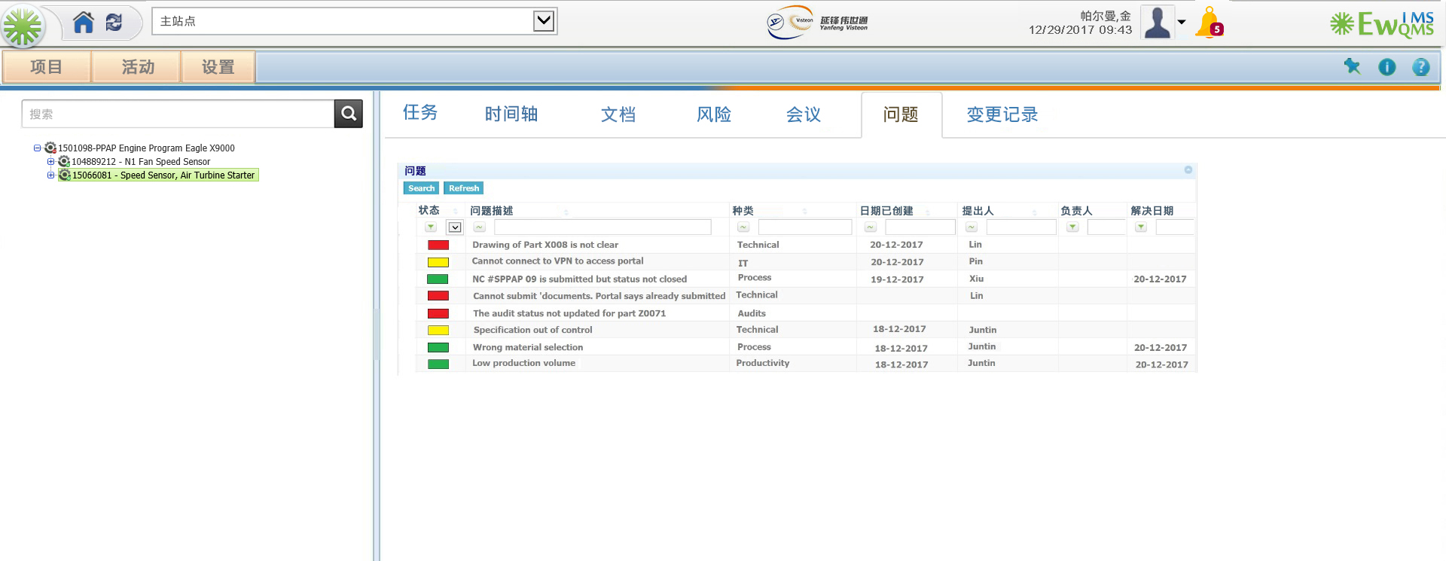

Slide 42
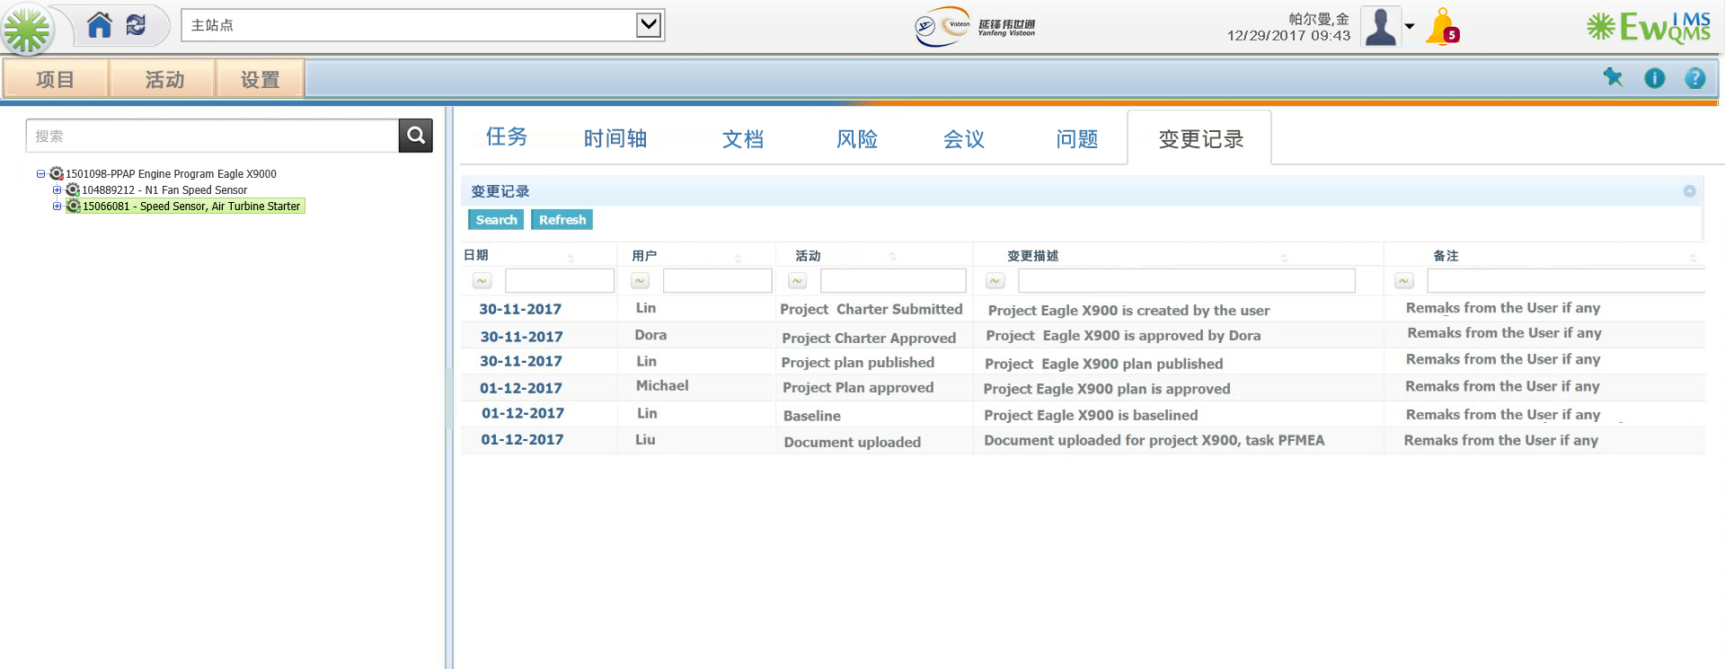

Slide 43

Project Implementation & Release

Slide 44
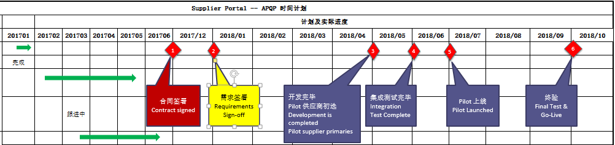
Yanfeng Supplier APQP Portal - Current Status of the Project 延锋供应商APQP入口-当前项目状态
Sabu
Timeline | Contract Signed |  | Effort
Month 1 | Requirements Sign-Off |  | 1 Month
Month 5 | Development Complete |  | 4 Months
Month 6 | Integration Testing Complete |  | 1 Month
Month 7 | Pilot Launch |  | 1 Month
Month 10 | Final Test & Go Live |  | 3 Months

Slide 45
Key Milestones / 关键里程碑
Sabu
Post Go – Live Support

Slide 46

Global Delivery Model / 全球交付模式
Global Software Development Centre – USA, China and India

Slide 47

Thank you / 谢谢

